Slide 1
Sustainability
londonmet.ac.uk/sustainability
/GreenLondonMet
@GreenLondonMet

Slide 2
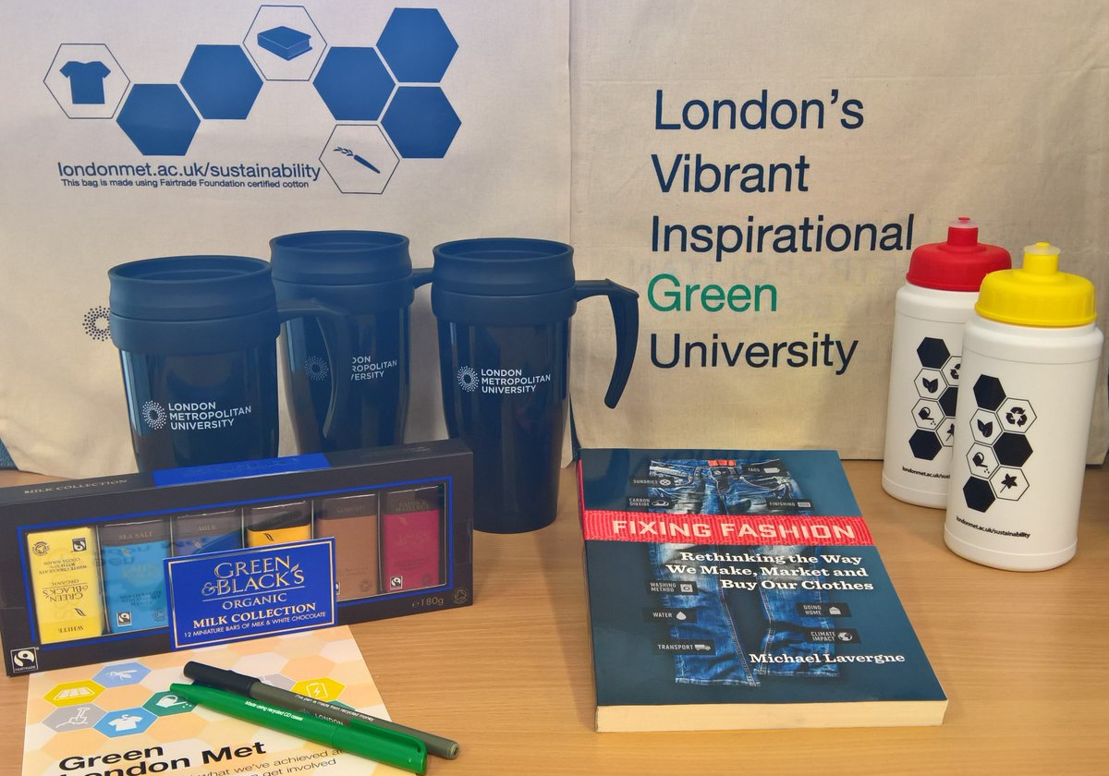
Sustainability essentials
This presentation will cover:
Environmental Sustainability at London Met
Who are the Sustainability Team?
Reducing Single Use Plastics
Recycling
Drinking water
Cycling
Green Spaces
Getting Involved
How to Report Issues

Slide 3
Environmental Sustainability
  London Metropolitan University was named as the number one University in England and Wales for carbon reduction in 2017. We have already exceeded our 2020 target of a 50% reduction and reduced our carbon emissions of 72% since 2009.
The University has won awards for its work on carbon reduction including a Green Apple Award, Edie, Public Sector Sustainability Awards and Green Gown Award.

Slide 4
Your Sustainability Team
Sustainability Assistant
Zanda Pipira
Z.pipira@londonmet.ac.uk
020 7133 3307
Student Union sustainability representative
Chrystalle Margallo
Chrystalle.margallo@londonmet.ac.uk
0207 133 4171

Slide 5
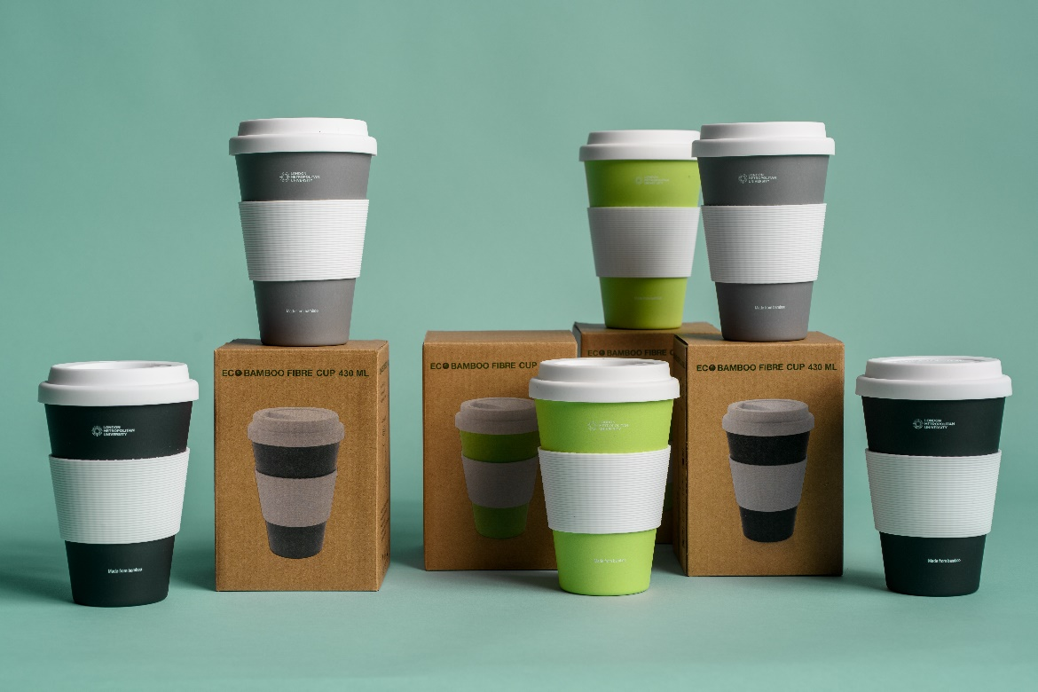
Reducing Single Use Plastics at the University
Reusable Travel Cups - refill a reusable bamboo mug on campus and save 20p on all hot drinks.
London Met bamboo cups are available for £7.50 each in our cafes - Blue Met, Learning Centre and the Junction.

Slide 6
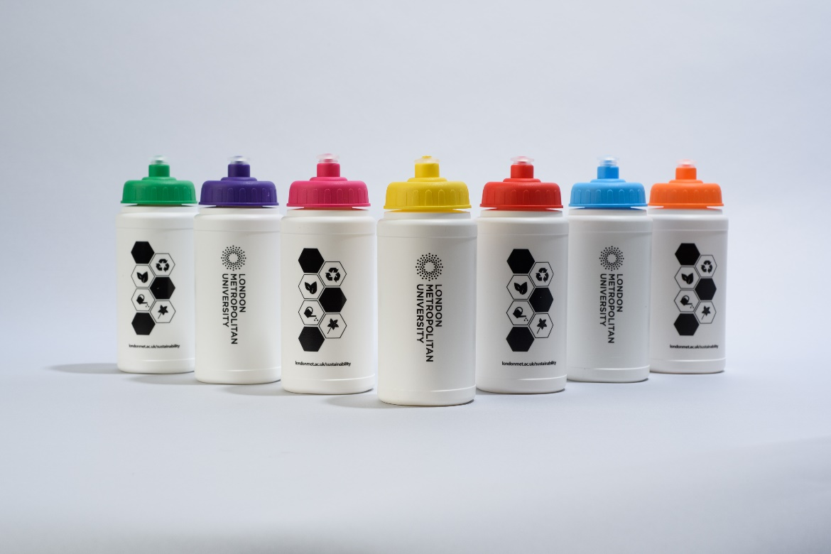
Reducing Single Use Plastics at the University
Compostable takeout containers –we use compostable containers to reduce plastic waste
Reusable water bottles – Refill your water bottle at our water fountains or ask any outlet on campus to refill it for you!

Slide 7
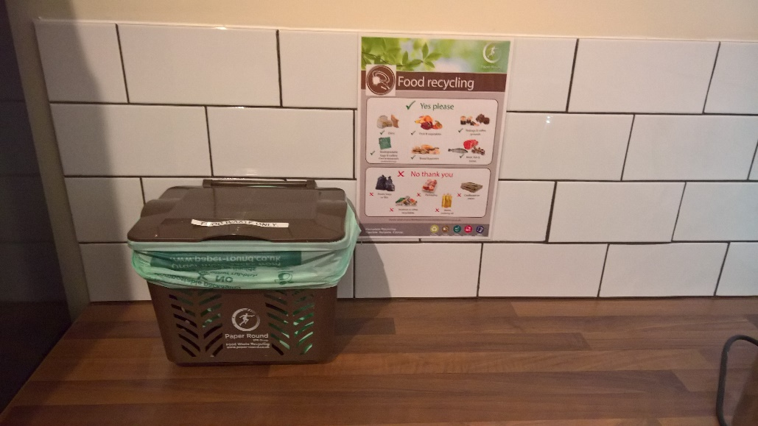
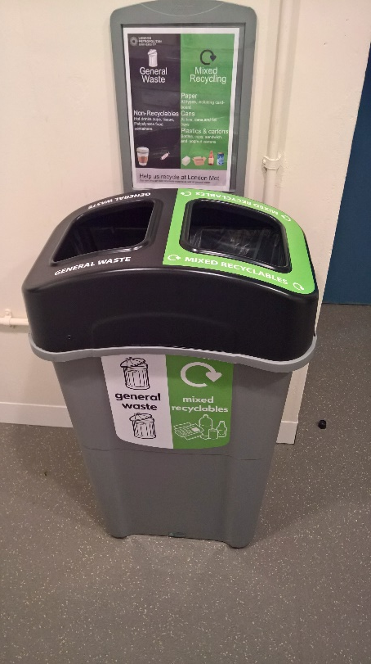
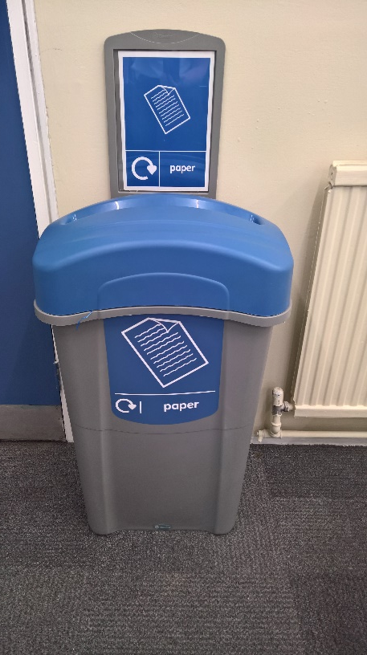
How to Recycle
None of the University’s waste goes to landfill.
Food – each staff kitchen has a brown food waste bin for any food leftovers.
General waste and mixed recycling - please use our dual bins black (general) & green (mixed recycling)
Paper - blue bins (found by the printers)

Slide 8
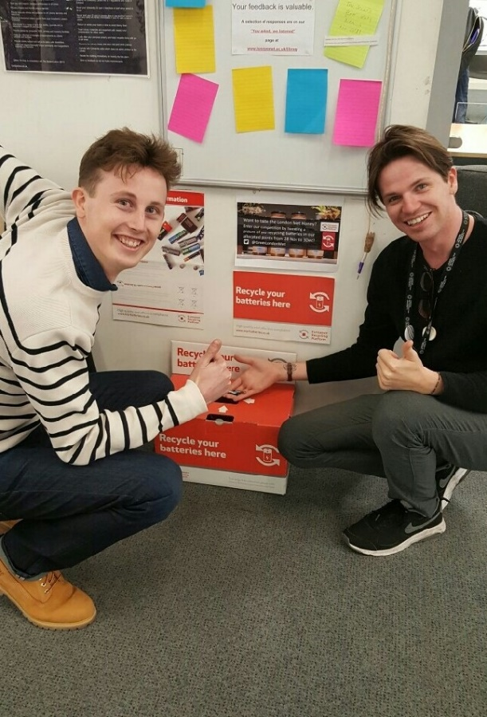
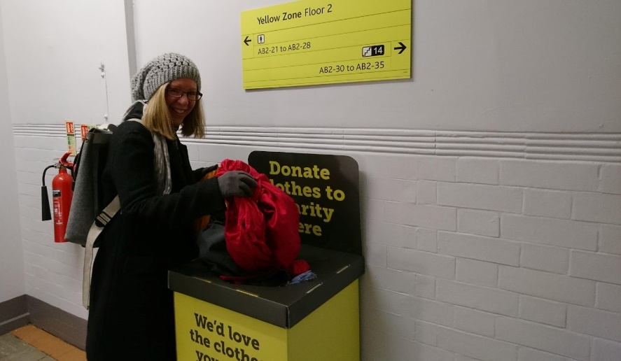
How to Recycle
Batteries – red battery bin boxes are available in libraries, ICT and Estates
Clothes – yellow TRAID boxes are provided in each building. Locations are available on our website

Slide 9
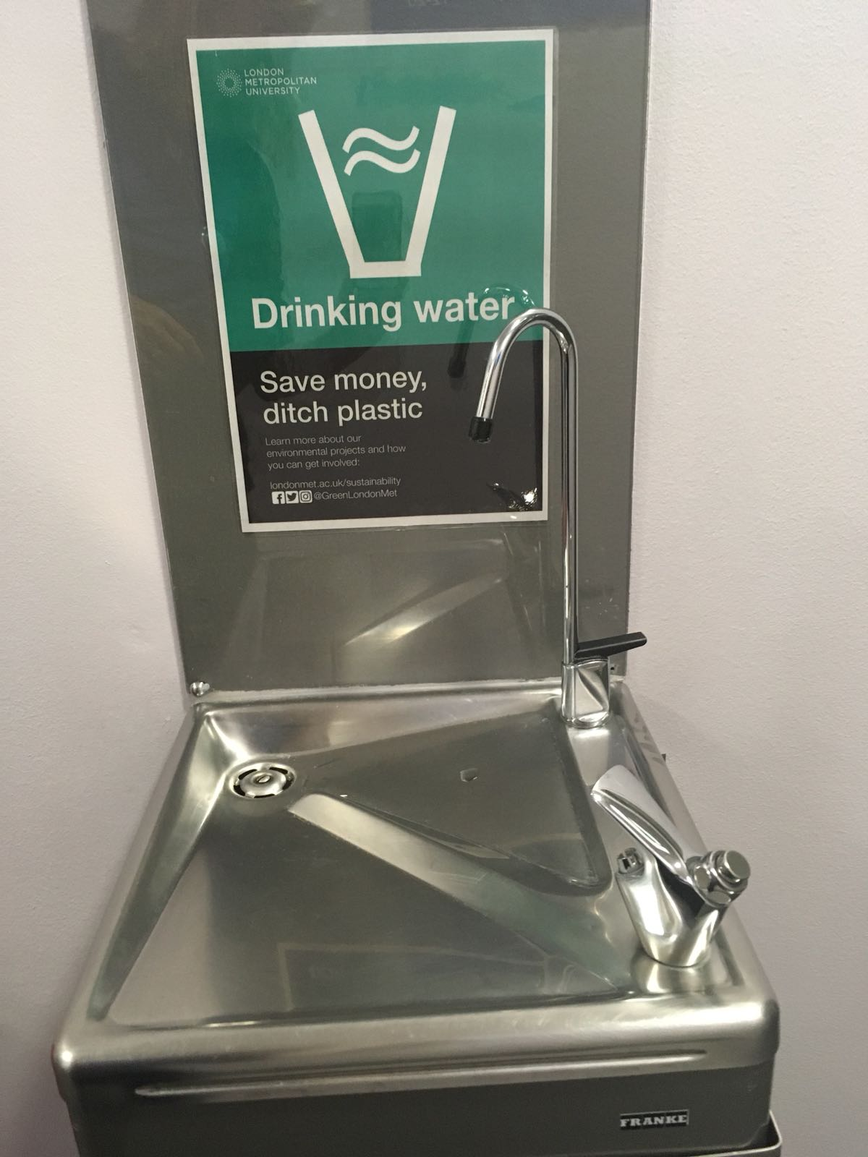
Drinking Water
There are water fountains across campus where you can get water.
Search for your nearest water fountain in our maps.
Holloway Road water map
Science Centre water map
Learning Centre water map
Calcutta House Water Map

Slide 10
Cycling
Building | Location | Description
Tower Building | Next to reception | 20 cycle hoops
Tower Building | Back of Highbury Canteen | Covered cycle shelter access via gate 8 (10 spaces)
Tower | By TSG-01 leading to Highbury Canteen. Closest reception - The Rocket | 10 lockers for folding bicycles
Graduate Centre | Next to Graduate Centre entrance | 10 cycle hoops
Learning Centre/Science Centre | Carpark between Science Centre and Learning Centre | Covered cycle shelter with 14 spaces, request access from Science Centre reception
Learning Centre | Outside the building | 16 cycle hoops
Goulston Street/Old Castle Street | Between Goulston Street and Old Castle Street | Covered cycle shelter with 10 spaces, access via Goulston Street, request access from reception,
Goulston Street/Old Castle Street | Between Goulston Street and Old Castle Street | 28 lockers for folding bicycles
Goulston Street | Outside the building | 9 cycle hoops
Goulston Street | Outside the building, on east side of street outside the library windows | 4 cyclestands are installed on east side of street outside the library windows, parallel to kerb
Calcutta House | Old Castle Street, east side of street south of Pomell Way | 3 cycle stands on east side of street south of Pommell Way, in line with trees/existing cycle stands
Calcutta House | Old Castle Street | 9 onsite cycle hoops next to Calcutta House and Calcutta House Annex
Calcutta House | Old Castle Street, west side of street adjacent to Calcutta House | 3 cycle stands on west side of street adjacent to Calcutta House, parallel to kerb, immediately north of existing cycle stands
Cycle parking spaces are available in the following locations

Slide 11
Cycling
Shower facilities
You can use gym changing rooms and showers in the following locations:
Tower Building Benwell Extension on the third floor next to the sports hall and dance studio
Gym changing rooms and shower at the Science Centre
Calcutta House ground floor Fitness Room
Lockers
We have lockers for folding bicycles at Holloway Road next to TSG-01.
Dr Bike Maintenance Sessions
The University runs Dr Bikes sessions where experienced mechanics check everything on your bike from wheels, brakes, gears and tyre pressure to lights, racks, pedals and saddles. The latest sessions are available here.

Slide 12
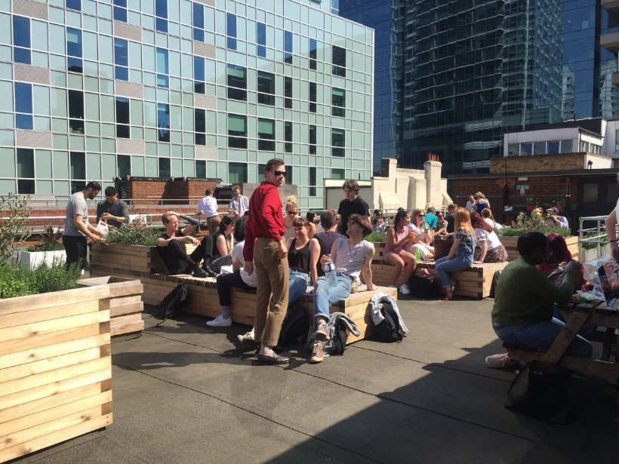
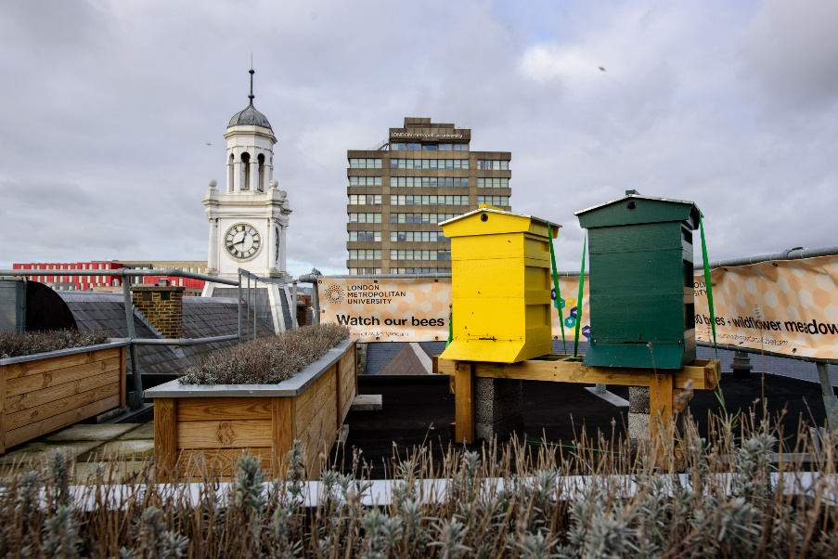
Green Spaces and Biodiversity
Although we are based in the city we have
several green spaces you can enjoy:
The gardens at Old Castle Street
Holloway road campus Green Zone
lounge patio
The Calcutta House rooftop garden
Holloway Road roof garden
London Met bees - we have installed two beehives on top of the roof in our Holloway campus with 40,000 bees. You can also watch the bees live online.

Slide 13
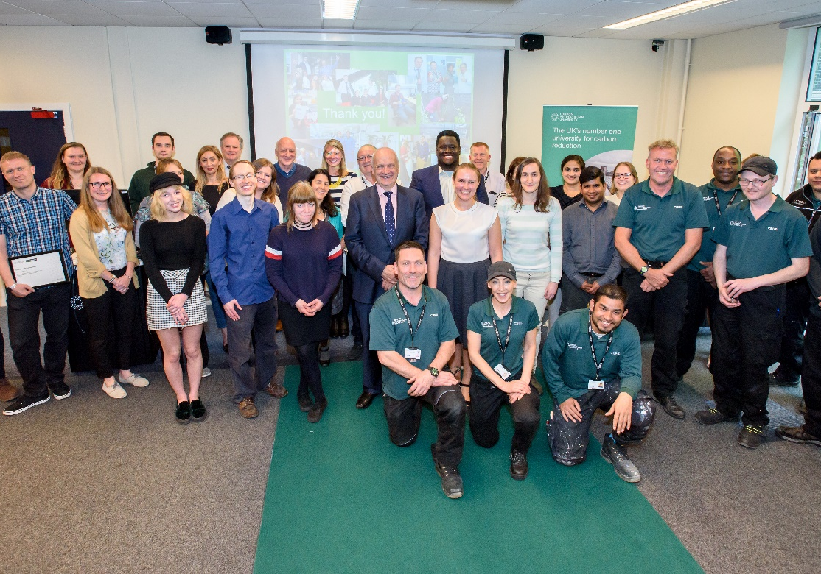
Get Involved - take part in Green Impact
Green Impact is a simple and effective way for departments and teams to improve their health and wellbeing; connect with other staff across the organisation; and make positive changes to the workplace and our environment.
Register your team at Green Impact!

Slide 14
Get Involved - Environmental Sustainability Management Team
The main purpose of the group is to develop and implement ideas to help reduce the environmental impact of the University. We meet around 4 - 6 times per year.
If there is something you are interested in such as increasing recycling or a project you would like to implement at the University we will help. The meeting is also a forum where you can raise issues that you might have seen across the University.
Join the Environmental Sustainability Management Team to raise any issues you are concerned about and find out what others are doing.

Slide 15
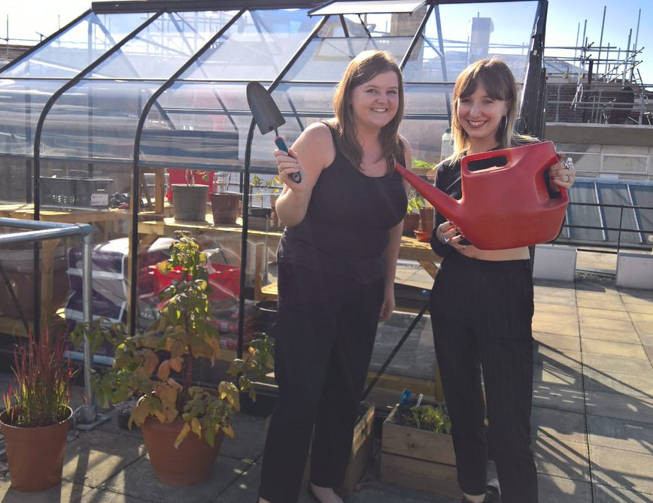
Get Involved
Become a member of Gardening Club
Everyone has a chance to grow and take home veggies and herbs as well as have lunch on the roof. Gardening Club runs Wednesdays 1-2pm at Tower Building during Summer time.
Sustainability monthly newsletter
Sign up to our monthly news to keep up to date with sustainability new and events across the campuses.

Slide 16

How to Report Any Issues
Please report any dripping taps, flickering lights, broken radiator valves, lights left on, heating issues, recycling, broken cycle lockers etc.
Please contact the Estates Help Desk on:
Self Service Helpdesk: https://servicedesk.londonmet.ac.uk/sw/selfservice/
Cross site telephone number x 5555 via email ask@londonmet.ac.uk

Slide 17
Further information
Further information about what the University is doing to reduce it's environmental impact is available on our website www.londonmet.ac.uk/sustainability
If you have any questions, please email the team at sustainability@londonmet.ac.uk.
Follow us on Twitter, Facebook and Instagram @GreenLondonMet to receive updates and read our news stories to find out more about our projects.

